Slide 1
MDDF 2023 Spec Updates
February 2024

Slide 2
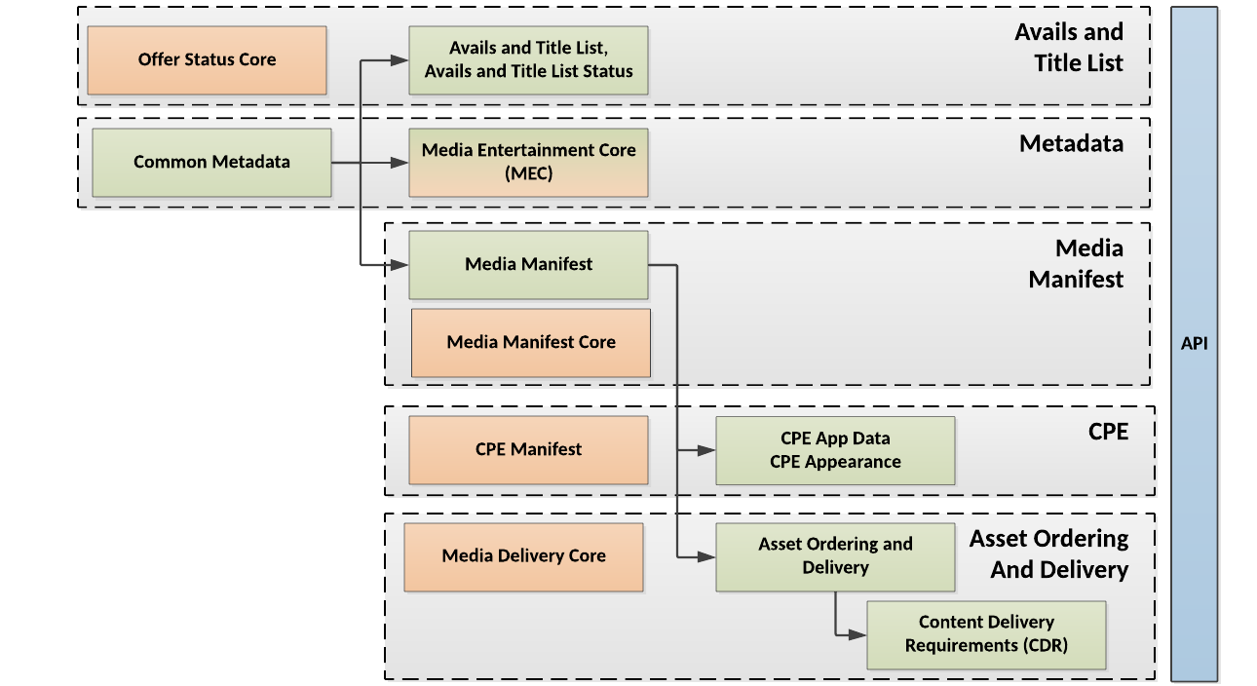
MDDF Updates
Spec updates
Common Metadata v2.12
Media Entertainment Core v2.12
Common Media Manifest 1.13
Schema Updates
MD 2.12
MEC 2.12
Manifest 1.13
Scheme updates to reference md v2.12
Avails 2.6.2
Delivery 1.4

Slide 3
Best Practices
Guidance for Conforming Tracks and Referencing Them
This practice defines how to align tracks when timecodes are not necessarily aligned.
Dolby-E Channel Mapping
This practice defines how to encode reference Dolby-E audio in Manifest Channel Mapping
Playlists Encoding Best Practice
This practice defines the method for describing a Playlist in Media Manifest. Playlists are sequences of distinct works that play back-to-back, such as a promo followed by a recap followed by an episode.
Live Events [DRAFT]
This practice defines the method for describing a Playlist in Media Manifest. Playlists are sequences of distinct works that play back-to-back, such as a promo followed by a recap followed by an episode.
Notes:
Discussion
Focus of continuing programs

Slide 4
Live Events
Problem
Live events needs information not in CM
People grouping (e.g., teams, bands)
Location/Venue
Timeframe
Activity (e.g., Sport, Concert, etc.)
Solution
Add following element to Basic/
Group
Place
Activity
Timeframe
WorkType
Added: Tournament, Tournament Stage, Tournament Round, Concert
Clarified ‘Music Video’ to ambiguity
Clarified Non-episodic Show
Drafted Best Practice for Sports and Concerts (work in progress)
OrgName elements can be localized

Slide 5
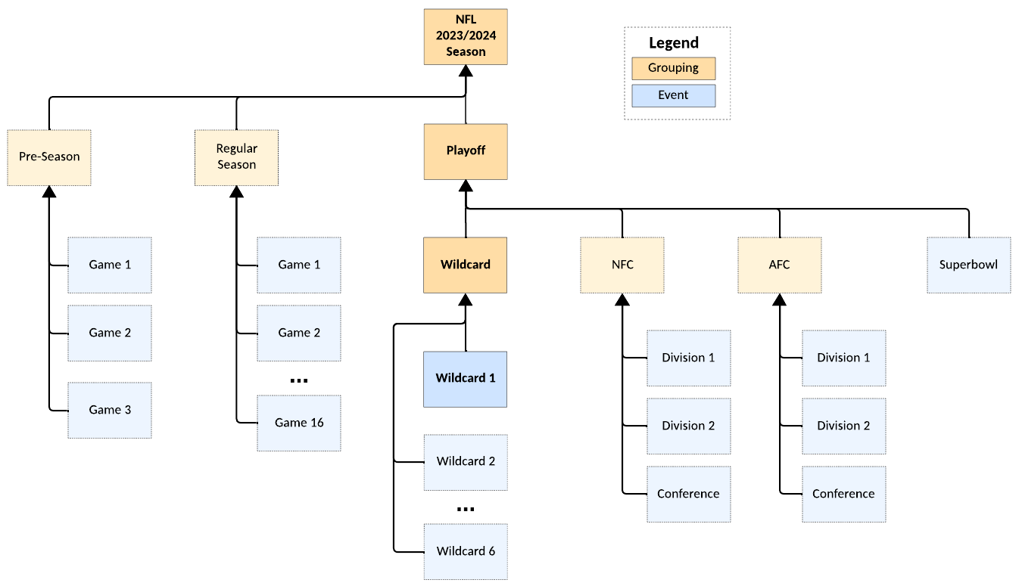
Live Events (continued)
Problem
Solution
Use existing Common Metadata grouping based on “Parent”
WorkType has grouping elements (e.g., Tournament)
Can also use existing grouping elements like “Season”
Sports Season
Season of “Sunday Night Football”

Slide 6
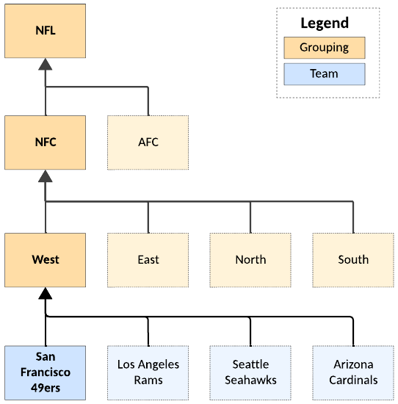
Group of People
Problem
Need means to express sports teams, bands, and other groups
People element isn’t sufficient
Solution
Added Basic/Group (BasicMetadataGroup-type)
Localized metadata: Description, Image
Identifiers
People in group (same as People element)
Supports hierarchy (ParentGroup)
Individual people go here

Slide 7
Activity
Problem
No way to describe an activity such as a sport or concert
Solution
Added Basic/Activity (Activity-type)
Type, SubType
To be defined in Best Practices
Localized: Name, SubName
Identifier
Standard identifiers can be defined in Best Practices

Slide 8
Listing Order
Problem
Certain element require more than one instance, but some implementations don’t handle multiple
Need ability to drive which are listed, typically when there is only one
Solution
Added @listingOrder to indicate preferred order (when all else fails)
Added to
Basic/
CountryOfOrigin
PrimarySpokenLanguage
OriginalLanguage
Video/Language

Slide 9
MEC Signature
Problem
In some workflows, provenance of a metadata record needs to be authenticated
Solution
Add XMLDSIG signature
Replicates model for signing Avails

Slide 10
Common Metadata Misc. (1 of 2)
Basic
Added FrameRate (formerly only in Manifest)
Added SecurityTitle with @expiration
Useful for pre-release and as a factoid
Added @spoken, @written, and @signed to OriginalLanguage
Added md:Terms to Basic/ and LocalizedInfo/
Adds flexibility for arbitrary addition of name/value pairs
Downside is potential for ad hoc undocumented practices
ContentRelatedTo
Added Venue and Activity to ContentRelatedTo
Restructured type definitions (e.g., Period based on Timeframe-type)
Added @interpretation to CountryOfOrigin
With goal of deprecating @intepretation
This is backwards compatible, but might cause problem when some use one and some use the other
I’m not sure anyone is using this
Plan is to delete in next revision

Slide 11
Common Metadata Misc. (2 of 2)
Basic
Fixed RegionUnion-type (not used in other types)
Added MadeForRegionExcluded to allow for “Domestic” and “International” EIDR definitions
Additional md:Term types added Binary and Label
VersionIntent/Description/@source added to align with EIDR
Editorial
Fixed spelling of ‘isbasedon’ enumeration in BasicMetadataParent-type/@relationshipType (not backward compatible, considered low risk since this is a relatively new feature)
Added Binary (with @MIME and description) and Label (string with @namespace and @level) to Terms-type

Slide 12
Dolby-E
Problem
Dolby-E multiplexes multiple channels into two audio channels
Channel Mapping cannot be inferred without additional information
Solution
Add Dolby-E Codec to list of valid codecs
Two channel mapping alternatives supplied in Best Practice
One option that covers most (if not all cases)
Uses Dolby nomenclature (from spec)
Does not provide for the Dolby E channels in a container with more than just the 2 Dolby E tracks
For example, “0L, 0C, 0Ls, 1L, 0R, 0LFE, 0Rs, 1R”
Another option is custom encoding
For example, “L,R,C,LFE,LS,RS,DE011,DE111”
Notes:
Discussion
Focus of continuing programs

Slide 13
Audio tracks in individual files
Problem
There is no clear documentation on how to handle one channel per file
Typically, they are in directories with naming like this:
filename.L.wav
filename.R.wav
filename.C.wav
filename.LFE.wav
filename.Ls.wav
filename.Rs.wav
Solution
Added ChannelMapping/@isMultipleFiles Boolean
Added ContainerReference/SequenceParsing/PatternSpec = “audio”
This is the default if not specified
Other patterns can be specified in SequenceParsing (also used for image sequences)
Added ‘alphabetical’ in case channel files are in alphabetical order

Slide 14
Image Metadata
Problem
Image metadata was insufficient, especially for print
Solution
Primaries
Added note that Rec.709 matches sRGB
Added “opRGB” (AKA Adobe RGB)
Added Image/ColorModel (CMYK, RGB, Monochrome)
Added PrintProfile
PPI (Pixels Per Inch) – like DPI only correct
SpotColor – used when specific inks are specified
PrintSpecification – Print-specific specs such as SWOP, GRACoL, and CGATS21

Slide 15
Digital Asset Metadata Misc. (CM and Manifest)
Added CBR (constant bitrate as xs:boolean) to
Audio/Encoding
Video/Encoding
To Audio/Picture/Progressive added @pulldown (e.g., “3:2”, “2:2:2:4”)
Added Subtitle FormatType values for analog: CEA-708, CEA-608, ETSI Teletext
Added Subtitle/Properties/TranslatorCreditPresent xs:boolean

Slide 16
Timed Events in Presentation
Problem
Needed richer timed metadata (countless use cases)
Ability to annotate a portion of Presentation timeline with virtually any annotation
Markers and Chapters weren’t enough
Solution
Added TimedEvents to Presentation (references TimedEventList-type)
Formerly attached only to top-level Manifest
Added TimedEventList-type with list of TimedEvents
Mirrors pattern in other top-level Manifest objects
Added to TimedEvent
Confidence – Especially useful for automated processing
PictureArea
Error information (for QC)
etc.

Slide 17
Dub Card Ambiguity
Problem
When there are multiple dubs in the same language, it is ambiguous which dub card goes with a given dub
Solution
Added @clipID to each type in PlayableSequence/ (Clip, ImageClip)
This is necessary when dub card is a subset of a video (i.e., need in and out from Clip)
Added Audio/DubCardRef (InventoryAudioCardRef-type)
References @clipID (for Playable Sequences), PlayableSequenceID, VideoTrackID or ImageID

Slide 18
Media Manifest Misc.
Clarified language around multiple video tracks (more common with HD and 4K/HDR)’
Editorial

